Slide 1
Biology and Behavior
Chapters 6, 7, and 8
Lecture Notes

Slide 2
Key Question
Are physiological responses a correlate of the trait in question, or are they a cause?
Example: Are shy people shy because they have certain physiological responses such as an increased heart rate, or are they shy because of some biological system that makes them that way?

Slide 3
Genetic Disorders and Personality
Angelman Syndrome
Williams Syndrome
Genetic disorder causing mental deficits, seizures, and limited sleep
People who have it are excessively happy and good-natured, attractive and friendly, with a strong need for human contact. They’re also mentally delayed, have seizures, and sleep very little.
Rare disorder characterized by physical & developmental problems, but personality is very sociable and friendly

Slide 4
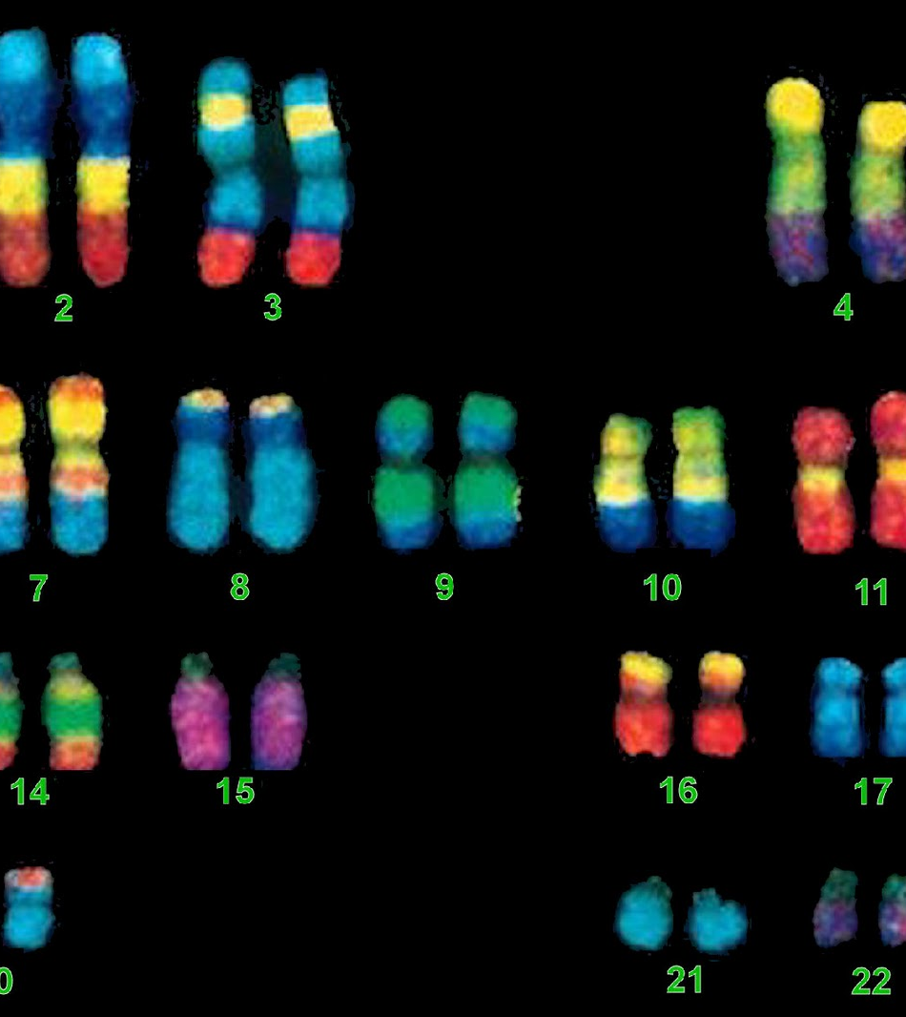
The Human Genome
The complete set of genes an organism possesses.

Slide 5
Genes
Humans have between 20,000 and 30,000 genes
Located on 23 pairs of chromosomes
Chromosomes contain genes, which contain long sequences of DNA molecules
Nucleus of each cell in the body (except egg and sperm cells) contains 2 complete sets of the human genome (one from Mom, one from Dad)
We all have about 100 trillion copies of our genome in our bodies.

Slide 6
Eugenics
The idea that we can tailor the human race by fostering reproduction of the “most desirable” among us and discouraging the reproduction of those who are less desirable.
Social Darwinism is the idea that not only individuals but societies compete for survival of the fittest
This leads to all sorts of problems, such as the Holocaust and the unfair immigration practices in the U.S. in the 1920s.

Slide 7
Heritability
A statistic referring to the proportion of observed variance in a GROUP of individuals that can be accounted by genetic variance.
It’s the degree to which genetic differences among individuals cause differences in an observed property (height, extraversion).
Formal definition: the proportion of phenotypic (observed) variance that is attributable to genotypic variance.

Slide 8
Misconceptions about Heritability
Heritability cannot be applied to a single individual (only to a population).
Heritability is not constant—changes as environments change, and it differs among cultures.
Heritability is an estimate, not a precise statistic.

Slide 9
Calculating Heritability
Using twin studies, calculate the correlations on a specific trait between identical and fraternal twins.
Subtract the correlation between the two and double the difference.
Example: MZr = .70; DZr = .40. 2 (.70-.40) = .60 (heritability estimate).
This means that 60% of the variance in the observed trait is due to heredity, and 40% is due to environmental influences.

Slide 10
Minnesota Twin Study
Followed 45 sets of identical twins reared apart and 26 sets of fraternal twins reared apart
Found moderate heritability estimates for most traits.
Highest correlations were absorption/imagination (.74) and neuroticism (.70). Aggression was 3rd at .67.
**In general, the Big Five traits have heritability estimates ranging around .50.

Slide 11
Sexual Orientation
Latest research shows that heritability estimates are weaker than first thought (20% in men, 24% in women, compared with previous studies in the 40-50% range)
Gender nonconformity in childhood is strongly related to homosexuality in adulthood and has heritability estimates of .50 for men and .37 for women.
Bem’s Exotic Becomes Erotic Theory (1996)

Slide 12
Shared vs. Nonshared Environments
Nonshared environments are the key factor in personality differences; shared environments have relatively little impact
However, some attitudes (e.g., religious & political beliefs) show effects from shared environments, as do depression and autonomous functioning.

Slide 13
Genotype-environment interactions
Different responses of individuals with different genotypes to different environments
Scarr & McCartney’s research
  Active G-E correlation (genes lead you to actively choose your environment)
  Passive G-E correlation—Parents choose your environment for you (mainly because of parents’ genes)
  Evocative or reactive G-E correlation—others respond to you differently according to your temperament.

Slide 14
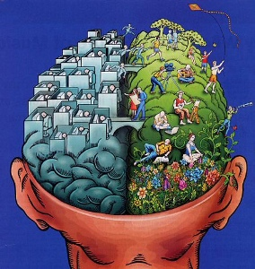
Physiologically Based Theories of Personality
Chapter 7

Slide 15
Assumption of Physiologically Based Theories of Personality
Different personality characteristics arise because of differences in physiological functioning
Biology is not merely a correlate of personality differences…it’s causal

Slide 16
Physiological Measures Used
Electrodermal activity (skin conductance)—sweatier skin indicates greater arousal (stress, anxiety)
Beats per minute (cardiovascular activity)—higher heart rates signal that body is preparing for action
EEG (electroencephalogram)—measures brain activity when certain responses are evoked (evoked potential technique)
Other methods--Blood and saliva analysis to check for cortisol

Slide 17
Extraversion/Introversion according to Eysenck
Thought that introverts had higher levels of activity in the brain’s ascending reticular activating system (ARAS) than extraverts do.
ARAS is thought to control cortical arousal. Introverts have a higher level of arousal than extraverts.
Introverts are easily overaroused, which makes them shy and inhibited. Extraverts need to be more outgoing to achieve their optimal level of arousal whereas introverts need to regulate their arousal downward.

Slide 18
Eysenck’s revision
Because of studies showing that baseline levels of arousal were the same between introverts and extraverts under levels of no or mild stimulation, Eysenck revised his theory.
True difference between extraverts and introverts lies in their arousability, not in baseline levels of arousal.
Geen (1984) confirmed that extraverts choose greater levels of stimulation than introverts.

Slide 19
Gray’s Reinforcement Sensitivity Theory
Theory of personality is based on the presence of two hypothetical brain constructs—the behavioral activation system (BAS) and behavioral inhibition system (BIS).
BAS is sensitive to rewards/approach behavior and is responsible for impulsivity.
BIS is sensitive to punishments/avoidance behavior and is responsible for anxiety.

Slide 20
Sensation Seeking
Tendency to seek out thrilling, exciting activities, take risks, and avoid boredom
Hebb’s theory of optimal arousal—We’re sometimes motivated to seek out tension and stimulation, not reduce it; everyone has a different optimal level of arousal.
Moderate positive correlation between extraversion and sensation seeking
High sensation seekers have low levels of MAO (an enzyme that maintains proper level of neurotransmitters), which produces a need for stimulation to reach optimal level of arousal.

Slide 21
Neurotransmitters and Personality
Dopamine—pleasure
Serotonin—depression/mood disorders
Norepinepherine—fight or flight
GABA—anxiety/panic attacks (low levels)

Slide 22
Cloninger’s Tridimensional Personality Model
Novelty seeking—low levels of dopamine
Harm avoidance—low levels of serotonin
Reward dependence—low levels of norepinpherine

Slide 23
Morningness/Eveningness
Larks/Owls—stable characteristic
Due to differences in biological rhythms (shorter rhythms → morning person; longer rhythms → evening person
People get along better when paired up with similar others on this dimension

Slide 24
Brain Asymmetry & Affective Style
Left frontal lobe associated with pleasant emotions (i.e., left is more active when experiencing pleasant emotions)
Right frontal lobe associated with unpleasant emotions
Dispositionally happy people show greater left frontal EEG activity; negative people show greater right lobe activity.
Is brain asymmetry in frontal activation a cause or an effect of dispositional happiness? Unknown.

Slide 25
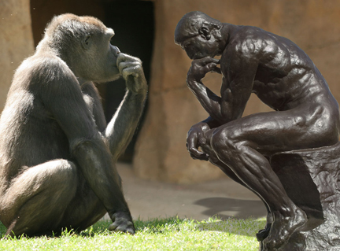
Evolutionary Psychology

Slide 26
Natural Selection
More offspring are produced than can survive and reproduce
The ones with the best adaptations are the ones who survive to the age where they can reproduce
Over time, these adaptations come to characterize an entire species.
Adaptations are inherited solutions to survival and reproductive problems posted by hostile forces of nature.

Slide 27
Sexual Selection
Some traits evolve not because they help a species survive but help them reproduce.
Two forms of sexual selection
  Intrasexual competition—members of the same sex compete with each other for access to the opposite sex.
  Intersexual competition—members of one sex choose a mate based on their preferences for particular qualities in that mate.

Slide 28
Inclusive fitness
It’s not just your own individual reproduction that matters; it’s that of your kin as well because they share your genes.
Explains why we act altruistically toward our own kin (kin selection).

Slide 29
Premises of Evolutionary Psychology
Domain-specificity (adaptations are designed to solve specific adaptive problems and are specific to the domain—such as eating or mating. Adaptations do not cross domains.)
Numerousness—there are many psychological adaptations because different adaptations are required to solve different adaptive problems.
Functionality—psychological adaptations are designed to accomplish particular adaptive goals. We must understand the functions before we understand our preferences (e.g., in mate selection)

Slide 30
Sex Differences
We expect males and females to be the same in the domains in which we’ve faced the same adaptive problems.
We expect them to be different in domains in which each sex has faced a different problem.
This has led to sex differences in aggression, jealousy, desire for sexual variety, and mate preferences.

Slide 31
Evolutionary triggers of individual differences
Environmental triggers of individual differences (e.g., research concerning father absence)
Heritable individual differences contingent on other traits (e.g., muscular people pursue more aggressive strategies)
Frequency-dependent strategic individual differences (restricted vs. unrestricted mating strategies in females)

Slide 32
Big Five and Evolution
Big Five personality traits are seen by evolutionary psychologists as clusters of key features of “adaptive landscapes” in people
Agreeableness → adaptive because it promotes selflessness and cooperation
Neuroticism → adaptive because it promotes vigilance to social danger

Slide 33
Limitations of Evolutionary Theory
We can’t go back to determine with certainty what the precise selective forces on humans have been in terms of adaptations
Forced to make inferences
Still don’t understand a lot of things
Modern conditions are different from ancestral conditions (what was adaptive in the past may not be adaptive today)
Sometimes easy to come up with different and competing evolutionary hypotheses for the same phenomena
Hard to test, sometimes accused of being unfalsifiable.

