Slide 1
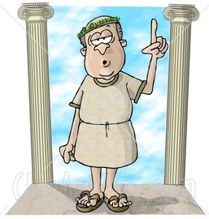
Philosophical Roots of Psychology

Slide 2
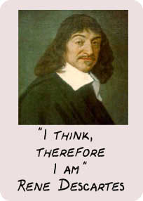
Rene Descartes
Father of modern philosophy
“I think; therefore I am”
Dualism

Slide 3
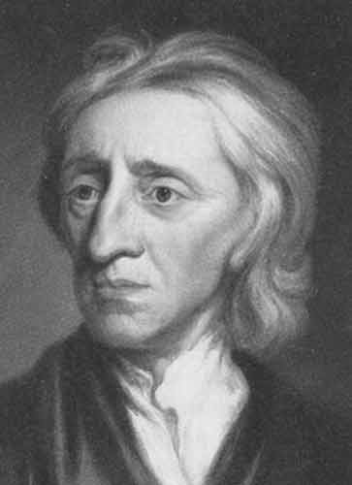
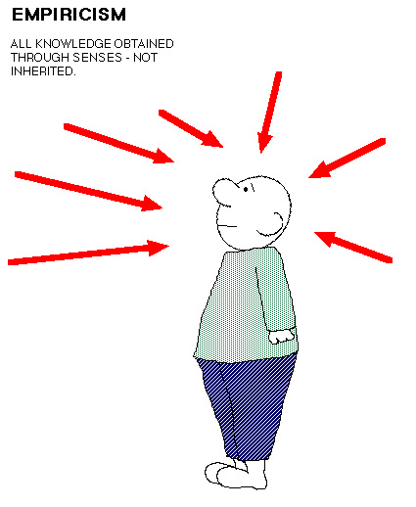
John Locke
Tabula Rasa—blank slate at birth
Primary contribution—making psychology an empirical science

Slide 4
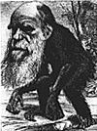
James Mill
Believed humans and animals are fundamentally the same
Laid the groundwork for modern theories that assume similarity between humans and animals

Slide 5
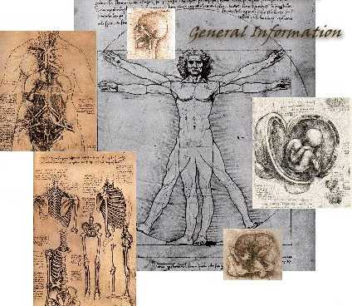
Physiology

Slide 6
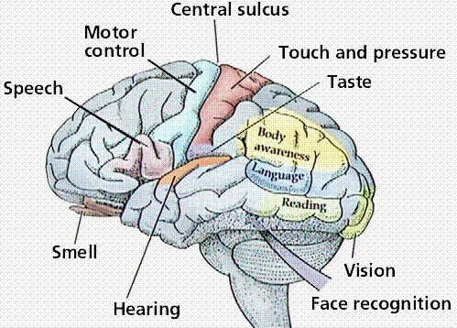
Johannes Muller
Recommended removal or isolation of organs to see how they worked
Doctrine of specific nerve energies—nerve impulses are the same, regardless of the source
Led to belief that brain must be specialized

Slide 7
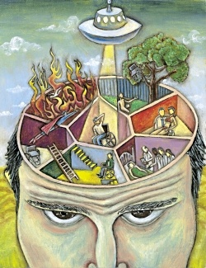
Hermann von Helmholtz
Measured speed of nerve impulses
Supported idea that mental events could be the subject of scientific investigation

Slide 8
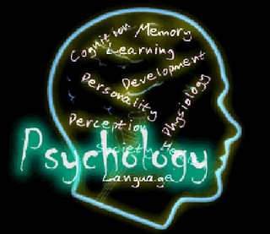
Philosophy + Physiology→
Psychology

Slide 9
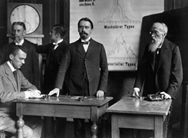
Structuralism: Wilhelm Wundt
Wilheim Wundt
Set up first psychological laboratory in Leipzig, Germany, in 1879
Considered the father of psychology
Wrote the first psych textbook

Slide 10
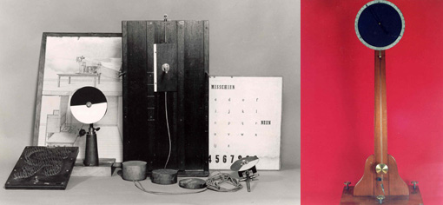
Wundt’s definitions of psychology
Science of immediate experience
Goal is to break down consciousness into its most basic elements to see how they’re related
Detailed analysis of consciousness called introspection
Picture shows tools from Wundt’s lab

Slide 11
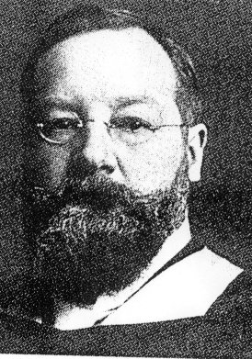
Edward Titchener
Student of Wundt’s
Famous for bringing structuralism to America

Slide 12
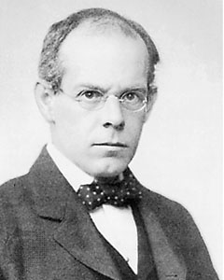
G. Stanley Hall
Student of Wundt’s, but not a true structuralist
Set up first psych lab in U.S. in 1892 at Johns Hopkins
Helped start the American Psychological Association (APA) and served as 1st president
Considered the father of
developmental psychology

Slide 13
Functionalism
Founder was William James
Goals
Focused on functions & process of conscious activity (perceiving and learning)
Focused on child development and educational practices
Very practical…functional
Influenced by Darwin’s natural selection idea
Believed consciousness is uniquely human; thus, it should be a focus of study.

Slide 14
Tenets of Functionalism
Study of mental operations and not mental structures
Mind and body are not indistinguishable
Purpose of psychological studies was to determine the relationship between an organism and its environment
Stimulus-organism-response (S-O-R model)

Slide 15
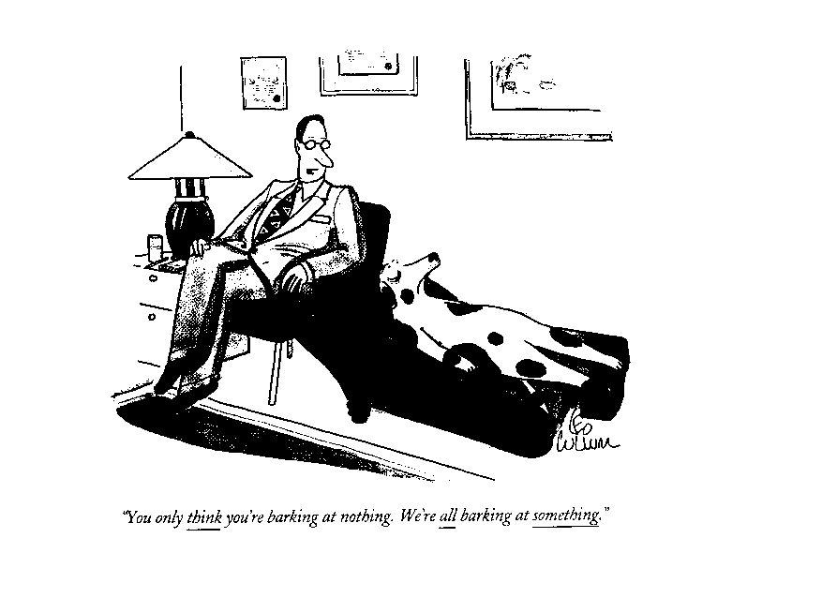
Functionalism Cartoon

Slide 16
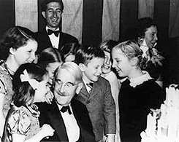
John Dewey
A functionalist whose influence was in progressive education around 1920
Believed children knew what was best for them—adults shouldn’t intervene in school or otherwise
Montessori schools are based on this idea

Slide 17
Progressive Education in Action
http://www.youtube.com/watch?v=opXKmwg8VQM&feature=fvw

Slide 18
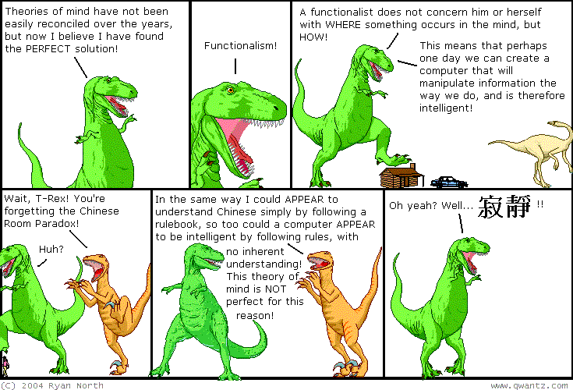
Epilogue of Functionalism
Ultimately failed as a school of thought
Closely related to evolutionary psychology today

Slide 19
Behaviorism
Replaced functionalism with John B. Watson’s article in 1913 calling for psychologists to study only overt behavior
The S-O-R (stimulus-organism-response) model became the S-R model (stimulus-response) because cognitive processes (the “O”) were not studied.
Really caught on because psychologists were tired of trying to pin down elements of consciousness
Behaviorism lasted for decades

Slide 20
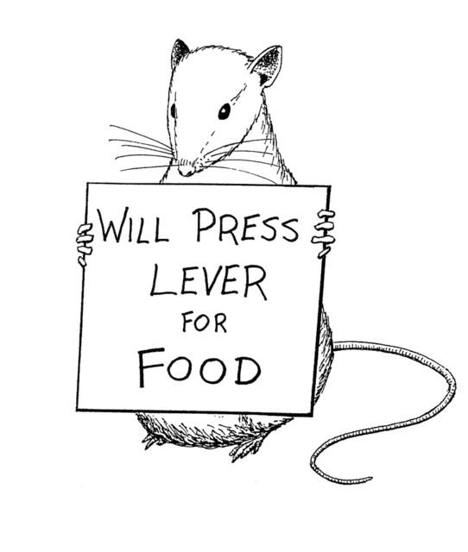
Important Behaviorists
Edward Thorndike (studied behavior of cats)
Ivan Pavlov (studied dogs’ response to a ringing bell that indicated food was about to be served)
John B. Watson—got the behavioral perspective really started
B.F. Skinner—did a lot of work in the field of learning (operant conditioning)

Slide 21
Video Clip of Skinner
http://video.google.com/videoplay?docid=-8956355585286146382

Slide 22
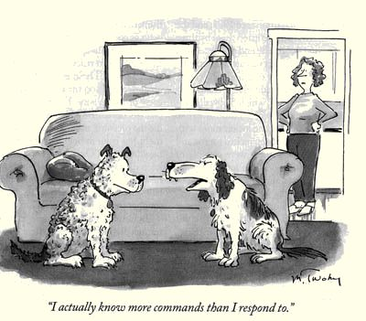
Impact of Behaviorism
Focused on objective science
Field evolved into “cognitive behaviorism,” which is now an effective therapy tool.
S-R model once again became S-O-R

Slide 23
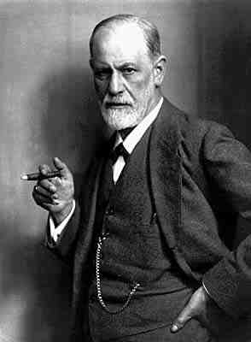
Psychodynamic/Psychoanalytic Theory
Occurred in Europe at the same time as behaviorism was going on in America
Pioneered by Sigmund Freud
Focused on functions of
consciousness
and unconsciousness,
biological drives and instincts

Slide 24
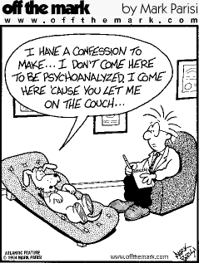
Psychoanalysis vs. Behaviorism

Slide 25
Humanism
Associated with Carl Rogers, Abraham Maslow
Arose in 1950s in direct opposition to both Freud and the behaviorists
Emphasized the unique qualities of people, freedom, and potential for personal growth
Unconditional positive regard
Largest impact was on clinical psychology

Slide 26
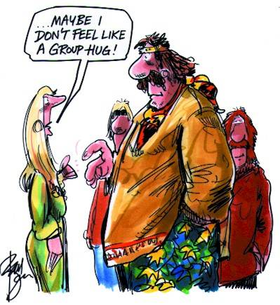
Humanism Cartoon

Slide 27
Rogers: Clip of Humanistic Therapy
http://www.youtube.com/watch?v=m30jsZx_Ngs&feature=related

Slide 28
Cognitive Revolution
The ultimate, most successful challenge to behaviorism
One of the most popular viewpoints in psychology today
Reestablished the study of consciousness
Aided by computers—they help us study mental processes (e.g., reaction time) more precisely

Slide 29
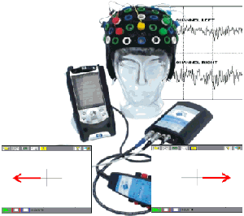
Information-processing approach
Information received through senses is “processed” by various systems of neurons in the brain (e.g., “memory system”)
Modern model of human brain is a computer
We now study mental structures, but not in the way Wundt did. We use the more objective behavioral methods that
behaviorists taught us.

Slide 30
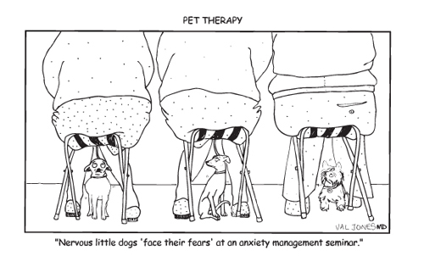
Cognitive-behavioral therapy
Involves changing maladaptive thoughts/feelings and the undesirable behaviors they produce
Considered by many to be the most effective type of therapy

Slide 31
Cognitive-Behavioral Therapy
http://www.youtube.com/watch?v=GqW8p9WPweQ&feature=related

