Slide 1
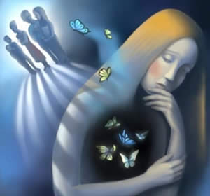
Personality Disorders

Slide 2
What are personality disorders?
Maladaptive variations or combinations of normal personality traits
Extremes on either end of specific trait dimensions can be associated with disorders.
An enduring pattern of experience and behavior that differs greatly from society’s expectations
Pattern is inflexible and pervasive and leads to significant distress or impairment in social, occupational, or other important areas of functioning.
Pattern is stable and of long duration.
Disorder is not better accounted for by anotehr mental disorder, drug use, or a medical condition.

Slide 3
Manifestations of Personality Disorders
Usually manifested in one or more of the following:
How people think
How they feel
How they get along with others
How they control their impulses or behaviors
Must take into account the effects of culture, age, gender, and ethnic background.

Slide 4
Clusters of Personality Disorders
Erratic
Antisocial
Borderline
Histrionic
Narcissistic
Eccentric
Schizoid
Schizotypal
Paranoid
Anxious
Avoidant
Dependent
Obsessive-compulsive

Slide 5
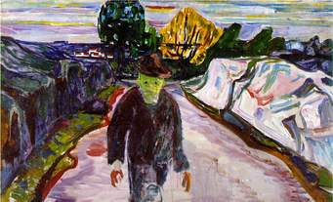
The Erratic Cluster
Known as Cluster B in the DSM 5
Ways of being unpredictable, violent, or emotional

Slide 6
General characteristics of Erratic Cluster
Characterized by trouble with emotional control and specific difficulties getting along with others; appear dramatic, emotional, and unpredictable

Slide 7
Antisocial Personality Disorder
General disregard for others
Childhood marked by behavioral problems, often early in life
Lack of concern for social norms
Repeated lying
Easily irritated and assaultive
Reckless
Irresponsible
Lack of remorse

Slide 8
DSM 5 criteria: Must have 3 +
Failure to obey the law
Repeated lying or conning for personal gain
No planning ahead
Repeated fights or assaults
Disregard for safety of self or others
Irresponsible, especially in work and bills
No remorse for harming others

Slide 9
Psychopathy
Difference with antisocial personality is that psychopaths exhibit superficial charm, egocentricity, shallow emotions, and lack of empathy
Focus of psychopathy is on the subjective experience, not objective behaviors (as in antisocial personality disorder)
Impulsive, lacking in shame, guilt, and fear
Psychopathy is mainly a research construct
Not all people with antisocial personality disorder are psychopaths
Most extreme psychopaths meet the criteria for antisocial personality disorder.

Slide 10
Borderline Personality Disorder
Intense, emotionally, and potentially violent relationships
Marked by insecurity, fear of abandonment
Self-mutilating behaviors and suicide attempts are common
See things in black & white (including self and relationships)
Feelings of emptiness inside
Strong emotions—panic, despair, anger—mainly caused by interpersonal events
Manipulative & demanding
Correlated with childhood physical & sexual abuse, early loss of love from parent(s)

Slide 11
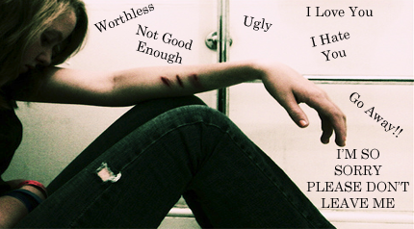
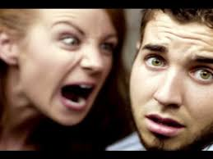
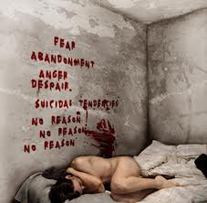
Borderline in Pictures

Slide 12
DSM Criteria: Must have 5+
Efforts to avoid being abandoned
Unstable, intense interpersonal relationships
Unstable self-esteem
Impulsive, self-damaging behaviors
Suicidal ideation or self-mutilation
Emotional instability which is intense
Feelings of emptiness
Anger issues
Transient paranoia or dissociation

Slide 13
Histrionic Personality Disorder
Excessive attention-seeking and emotionality
Overly dramatic
Charming, flirtatious, inappropriately seductive
Shallow, easily-changed opinions & values
Crave excitement & novelty, but interest doesn’t last long
May shown strong emotions in public; temper tantrums
Others view their emotions as theatrical & insincere
Hard to get along with because of excessive need for attention
Highly suggestible
Act impulsively

Slide 14
DSM Criteria: Must have 5 +
Uncomfortable when not the center of attention
Sexually seductive behavior
Shifting and shallow emotions
Uses physical appearance for attention
Alters speech to make an impression
Exaggerated expression of emotion
Easily influenced
Exaggerated intimacy of relationships

Slide 15
Narcissistic Personality Disorder
Strong need to be admired
Strong sense of self-importance
Lack of insight into others’ feelings
Strong feelings of entitlement
Sense of superiority is pervasive
Must receive regular praise/admiration from others
Grandiose self-esteem is actually fragile
Extremely sensitive to criticism; can fly into a rage when challenged or criticized
Hate accomplishments of others
Inability to recognize needs & desires of others
Self-enhancement in performance evaluation
Self-centered, emotionally cold, unwilling to give in relationships

Slide 16
DSM Criteria: Must have 5+
Grandiose sense of self-importance
Fantasies of greatness in many areas
Only wants to associate with other special people
Must be admired
Sense of entitlement
Exploits others
Lacks empathy
Problems with envy
Arrogant

Slide 17
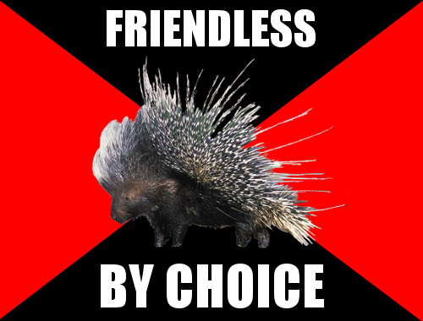
The Eccentric Cluster
Cluster A: Ways of Being Different—Ill-at-ease socially and just plain odd

Slide 18
Schizoid Personality Disorder
Detached or indifferent from normal social interactions
Appears to have no need for any relationships
Socially isolated
Little pleasure from bodily or sensory experiences
Bland, constricted emotional life
Appears socially inept or clumsy
Doesn’t respond to social cues
Passive in the face of unpleasant happenings
Appears directionless & socially numb

Slide 19
DSM Criteria: Must have 4 +
Not interested in close relationships
Chooses to be alone
No interest in sex with another
Enjoys hardly anything
Lacks close friends
Indifferent to criticism
Emotionally detached

Slide 20
Schizotypal Personality Disorder
Acutely uncomfortable in social situations
Socially anxious; fearful
Suspicious of others
Odd or eccentric
Believe in weird things (e.g., think they have magical powers)
Unusual perceptions bordering on hallucinations
Violate common social conventions

Slide 21
DSM Criteria: Must have 5+
Ideas of reference
Odd beliefs
Weird perceptual experiences
Odd thoughts and speech
Paranoid ideation
Inappropriate affect
Odd behavior or appearance
Lack of close friends
Social anxiety

Slide 22
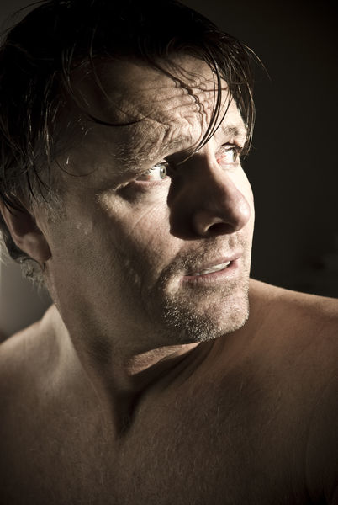
Paranoid Personality Disorder
Extremely distrustful of others
See others as a constant threat
Preoccupied with doubts about others’ motivations
Misinterpret social events
Constantly on the lookout for hidden meanings and disguised motivations in others
Resents others for slights & perceived insults
Argumentative & hostile

Slide 23
DSM Criteria: Must have 4+
Suspicious of others
Preoccupied with loyalty of friends
Won’t confide in others
Perceives threats in all kinds of things
Bears grudges
Perceives being disrespected
Questions faithfulness of romantic partner

Slide 24
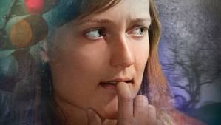
The Anxious Cluster
Cluster C: Ways of being nervous, fearful, or distressed.

Slide 25
Avoidant Personality Disorder
Pervasive feeling of inadequacy and sensitivity to criticism
Extreme social anxiety
Avoid making new friends because of fear
Feelings are easily hurt
Very low self-esteem
Feelings of inadequacy in daily life

Slide 26
DSM Criteria: Must have 4+
Avoids jobs involving people because of fear of rejection
Avoids people unless certain of being liked
Restrained intimate relations because of fear of rejection
Concerned about rejection in social situations
Avoids new interpersonal situations
Perceives self as socially inferior
Afraid of novel situations

Slide 27
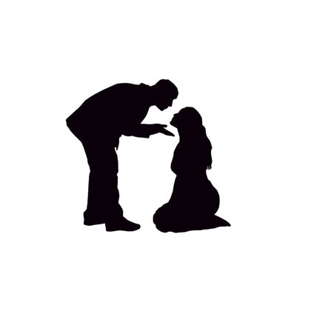
Dependent Personality Disorder
Seeks out others to an extreme degree
Excessive need to be taken care of, nurtured, and told what to do
Seeks out reassurance from others
Rarely takes the initiative
Avoids disagreements at all costs
May not work well independently
May tolerate extreme circumstances to keep others close

Slide 28
DSM Criteria: 5+
Problems with decisions without advice
Needs others to assume responsibility for self
Can’t disagree with others
Problems being independent regarding anything
Needs support from others
Afraid of being alone because can’t care for self
Bounces from one relationship to another
Afraid of having to care for self

Slide 29
Obsessive-Compulsive Personality Disorder
Preoccupied with order
Strives for perfection
Fondness for rules, rituals, schedules, & procedures
Holds very high standards for self & others
Devoted to work at the expense of friends and leisure
May appear inflexible regarding ethics & morals
Highly conscientious
Their way is the only way
Don’t like to work with others because they can’t delegate tasks
May hoard things or be stingy/miserly
Very stubborn

Slide 30
DSM Criteria: 4+
Preoccupied with small details while missing the point
Concern with perfection yields incomplete tasks
Workaholic
Inflexible regarding morals & values
Can’t discard useless objects
Can’t delegate work to others
Miser regarding money
Rigid and stubborn

Slide 31
Prevalence of Personality Disorders
13% overall have at least one disorder
Comorbidity is 25-50%
Differential diagnoses are a problem.
Obsessive-compulsive is most common type (over 4%)
Narcissistic is least common (0.5%), although this may be due to self-report bias.
Schizotypal, histrionic, & dependent each have a prevalence of 2%

Slide 32
Gender Differences
Overall prevalence rate is fairly equal, except for antisocial personality disorder (4.5% of men but only 0.8% of women).
Borderline and dependent are somewhat more prevalent among women; evidence is not strong.
OCPD and paranoid are somewhat more prevalent in men, but not a large difference.
May be gender differences in the manifestations of the disorders.

Slide 33
Dimensional Model
Group of personality psychologists tried to get personality disorders conceptualized as dimensional rather than categorical, but failed.
Dimensional approach: only distinction between normal personality traits & disorders is in the degree.
Disorders would be at the extremes of the dimension and show rigidity and maladaptiveness.
Advantages: explains why people in the same diagnostic category can behave so differently; allows for people to have multiple disorders

Slide 34
Personality Disorders in terms of traits (Widiger, 1997)
Borderline: extreme narcissism
Schizoid: extreme introversion + low neuroticism
Avoidant: extreme introversion + high neuroticism
Histrionic: extreme extraversion
OCPD: extreme conscientiousness
Schizotypal: complex combination of introversion, high neuroticism, low agreeableness, and extreme openness

Slide 35
Causes of Personality Disorders
Borderline
poor attachment relationships in childhood
Sexual abuse
Growing up in chaotic homes with a lot of exposure to impulsive behavior of adults
Very little evidence for genetics
Antisocial
Child abuse, drug/alcohol abuse
Some genetic causes (family studies)
Learning theory: Antisocials are insensitive to learning through punishmetn
Schizotypal
Genetically similar to schizophrenia (paranoid & avoidant personality disorders are also related to schizophrenia)

